Slide 1


Slide 2
OUR TEAM
P MALLESWARI
CH KAMAL PREETAM
K SAI PRASANNA KUMAR
K SATYA KEERTHI
K VIJAYA
17131A0588
CSE 2
3rd YEAR
17131A0589
CSE 2
3rd YEAR
17131A0590
CSE 2
3rd YEAR
17131A0591
CSE 2
3rd YEAR

Slide 3


Slide 4
https://preetamkamal.github.io/Covid19-Tracker/

Slide 5
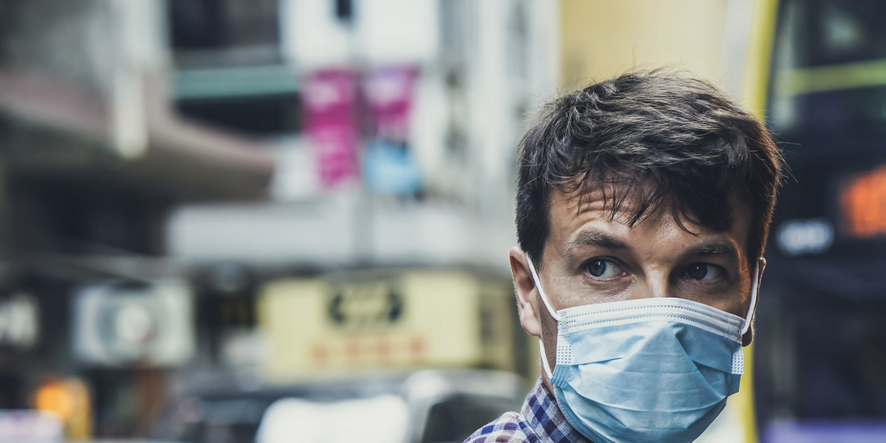
C-19
COVID-19
FACE MASK DECTION
USING DEEP LEARNING

Slide 6
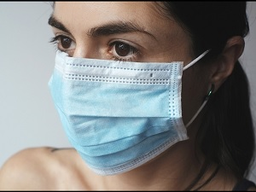
Face Mask Detection System uses existing IP cameras and CCTV .
Cameras combined with Computer Vision to detect people without masks.
MASK IS MOST IMPORTANT TO PREVENT COVID

Slide 7
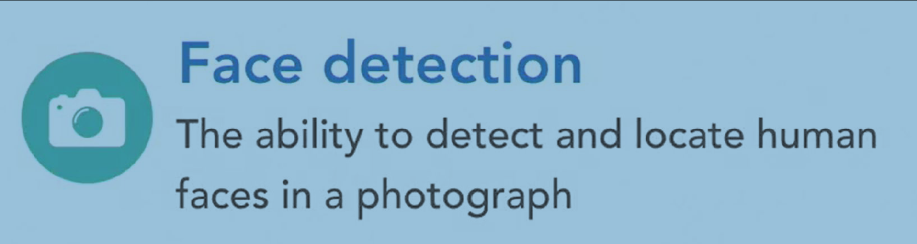

Slide 8
Face Mask Recognition Pipeline
04
Detect
Detect Face mask presence
Detect presence of face mask
03
Measure
Measure faces and create faceprint
Create faceprint for images
02
Identify
Identify Facial Features
Identifying facial features is done using openCV and dlib in python
01
Locate
Locate and Extract Faces
Extracting faces using openCV face detection Neural Networks

Slide 9
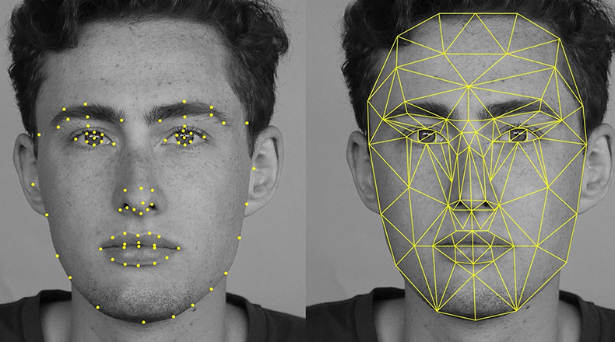

Slide 10
1
Open CV
https://opencv.org/
2
Caffee-Based Face detector
https://caffe.berkeleyvision.org/
3
Tensorflow
https://www.tensorflow.org/
Tech Framework
4
MobileVnet2
https://arxiv.org/abs/1801.04381

Slide 11
Phase 1: Train Face-Mask Dataset
Step 01
Step 02
Step 03
Load face mask dataset
Train face mask classifier with Keras/ Tensorflow
Serialize face mask classifier to disk

Slide 12
Phase 2: Apply Face Mask Detector
Step 01
Step 02
Step 03
Step 04
Load face mask classifier from disk
Detect faces in image/ video stream
Step 05
Extract each face ROI
Apply face mask classifier to each face ROI to determine “mask” or “no mask”
Show results

Slide 13
Accuracy of Models
Conventional Neural Network
Histogram of oriented gradients(HOG)
Viola-Jones

Slide 14
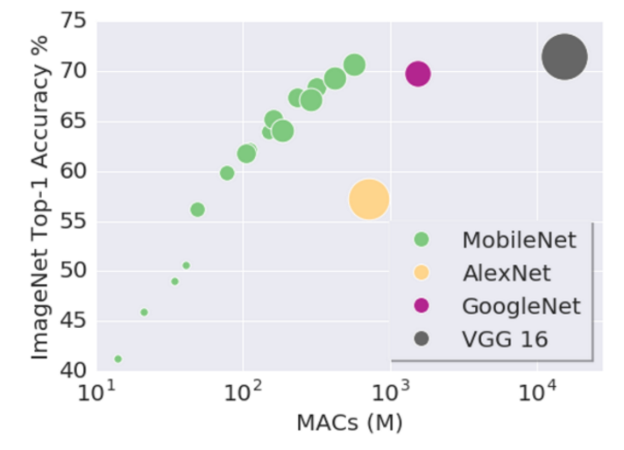

Slide 15
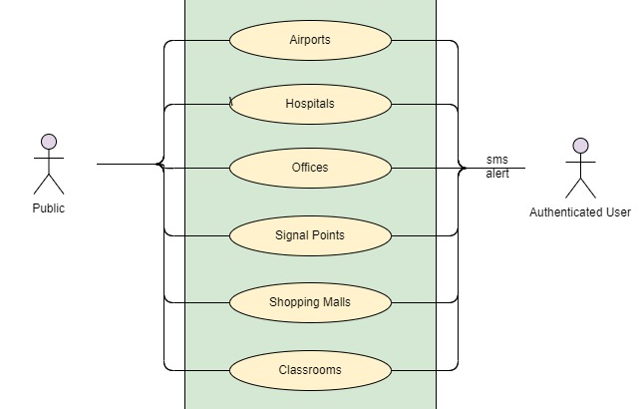

Slide 16
Google dataset search
https://datasetsearch.research.google.com/
Kaggle
http://kaggle.com/
Google images search
https://images.google.com/

